Slide 1
Government Action

Slide 2
Canada

Slide 3
1. Internationally
Canada is participating with other countries to reduce Greenhouse gas emissions

Slide 4
1. Internationally
Canada is participating with other countries to reduce Greenhouse gas emissions
IPCC → ongoing – study / understand climate change

Slide 5
1. Internationally
Canada is participating with other countries to reduce Greenhouse gas emissions
IPCC → ongoing – study / understand climate change (1988)
Kyoto Accord → reduction targets. We didn’t meet but still trying!

Slide 6
1. Internationally
Canada is participating with other countries to reduce Greenhouse gas emissions
IPCC → ongoing – study / understand climate change
Kyoto Accord → reduction targets. We didn’t meet but still trying!
Paris Agreement → Dec. 2015 -> targets to reduce climate warming by 2 ºC

Slide 7
1. Internationally
Canada is participating with other countries to reduce Greenhouse gas emissions
IPCC → ongoing – study / understand climate change
Kyoto Accord → reduction targets. We didn’t meet but still trying!
Paris Agreement → Dec. 2015 -> targets to reduce climate warming by 2 ºC
Reduction targets are set and emissions are monitored.

Slide 8
2. Canada is active in studying climate change
http://www.climatechange.gc.ca/default.asp?lang=En&n=F2DB1FBE-1
Record what we are doing:
1)
2)
3)
4)

Slide 9
3. Invest in clean energy
http://www.climatechange.gc.ca/default.asp?lang=En&n=72F16A84-1

Slide 10
3. Invest in clean energy
2 billion $ Low Carbon Economy Trust Fund → money to fund projects that reduce carbon emissions.
http://www.climatechange.gc.ca/default.asp?lang=En&n=72F16A84-1

Slide 11
3. Invest in clean energy
2 billion $ Low Carbon Economy Trust Fund → money to fund projects that reduce carbon emissions.
Reduce financial support for fossil fuel industry.
http://www.climatechange.gc.ca/default.asp?lang=En&n=72F16A84-1

Slide 12
Provincially - Ontario

Slide 13
Ontario
1. Cap & Trade - https://www.ontario.ca/page/cap-and-trade
- Set limits for GH gas emission (cap) but companies can trade leftover space (trade)

Slide 14
Ontario
1. Cap & Trade - https://www.ontario.ca/page/cap-and-trade
- Set limits for GH gas emission (cap) but companies can trade leftover space (trade)
- Those going over are fined! $$ . This money funds ‘clean’ energy development.

Slide 15
Ontario
1. Cap & Trade - https://www.ontario.ca/page/cap-and-trade
- Set limits for GH gas emission (cap) but companies can trade leftover space (trade)
- Those going over are fined! $$ . This money funds ‘clean’ energy development.
2. Green Investment Fund
Money to support clean energy innovation

Slide 16
Ontario
1. Cap & Trade - https://www.ontario.ca/page/cap-and-trade
- Set limits for GH gas emission (cap) but companies can trade leftover space (trade)
- Those going over are fined! $$ . This money funds ‘clean’ energy development.
2. Green Investment Fund
Money to support clean energy innovation
3. Targets
- 2015 – set target to 80% fewer GH gases than 1990!

Slide 17
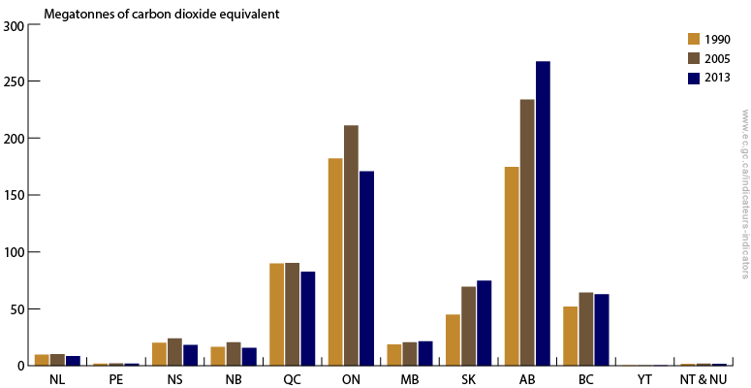
Ontario – large manufacturing province → has reduced! ☺
Alberta – producing more fossil fuel → has increased.
www.ec.gc.ca

Slide 18
Local - Guelph

Slide 19
Guelph http://guelph.ca/wp-content/uploads/EnergyAndEmissionsReport_brochure.pdf
Targets → Use 50% less energy by 2031
→ produce 60% less greenhouse gases by 2031
**Check out graph **

Slide 20
Guelph http://guelph.ca/wp-content/uploads/EnergyAndEmissionsReport_brochure.pdf
Plans
green energy – installing solar panels to generate electricity
Bike lanes – encourage bikes = less cars
Water conservation = less energy.

Slide 21
Local ideas to consider:
Industry → Use more efficient equipment
Farming → use less fertilizer (reduce N₂O)
Forests → plant more trees (Carbon sink)
Buildings → install better insulation (reduce heat/cool energy)

