Slide 1
History of Earth’s Climate & What’s Happening Now

Slide 2
What influences climate? - Geography-

Slide 3
What influences climate? - Geography-
Proximity to equator
closer = warmer

Slide 4
What influences climate? - Geography-
Proximity to equator
closer = warmer
Proximity to large bodies of water
closer = milder

Slide 5
What influences climate? - Geography-
Proximity to equator
closer = warmer
Proximity to large bodies of water
closer = milder
Presence of ocean/air currents
bring warm/cool temperatures

Slide 6
What influences climate? - Geography-
Proximity to equator
closer = warmer
Proximity to large bodies of water
closer = milder
Presence of ocean/air currents
bring warm/cool temperatures
Land formations
wet/damp on one side & dry on other

Slide 7
What influences climate? - Geography-
That’s why the climate varies around the world.

Slide 8
What influences climate? - earth’s orbit -

Slide 9
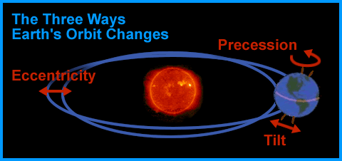
What influences climate? - earth’s orbit -
Earth’s orbit is not constant.

Slide 10
What influences climate? - earth’s orbit -
We have periodic warm and cool periods
(interglacial period & ice ages)

Slide 11
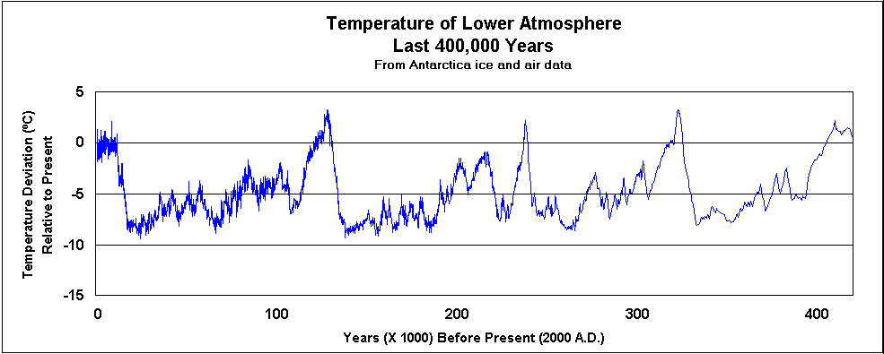
What influences climate? - earth’s orbit -
We have periodic warm and cool periods
(interglacial period & ice ages)
Pg. 349 - sketch
Note: regular intervals - approx. 100,000 years

Slide 12
Let’s look at Earth’s climate history
Video: A history of earth’s climate – by “SciShow”
https://www.youtube.com/watch?v=dC_2WXyORGA

Slide 13
Humans – Adding Greenhouse Gases
What are the main greenhouse gases? (G.H. gases)
CO2 – carbon dioxide
CH4 - methane
N2O - nitrous oxide

Slide 14
Humans – Adding Greenhouse Gases
Where are the G.H. gases coming from?
CO2 → burning fossil fuels & cutting down forests (carbon sinks)
CH4 → livestock farming & production of fossil fuels
N2O → farm fertilizers

Slide 15
Humans – Adding Greenhouse Gases
Let’s see what G.H. gases do:
Phet simulation
https://phet.colorado.edu/en/simulation/legacy/greenhouse

Slide 16
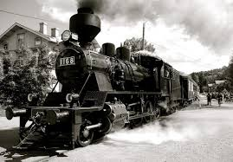
Influence of Industrial Revolution
Industrial Revolution – early 1800’s
Time when machines/motors were invented. Suddenly burning a lot of fossil fuels!
(But our lifestyle improved).

Slide 17
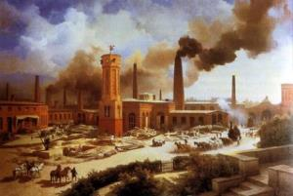
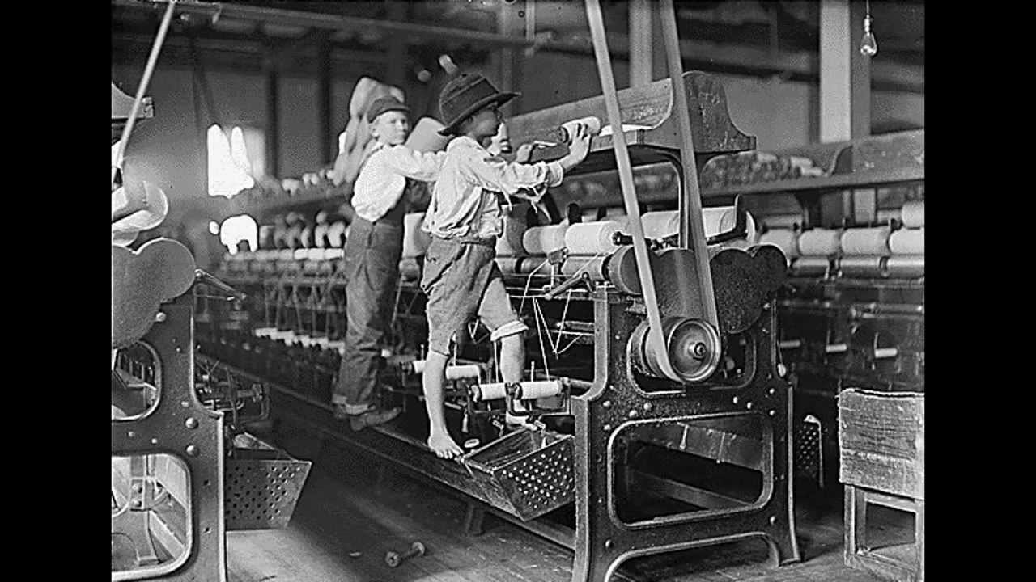
Influence of Industrial Revolution
Industrial Revolution – early 1800’s
Time when machines/motors were invented. Suddenly burning a lot of fossil fuels!
(But our lifestyle improved). ….???

Slide 18
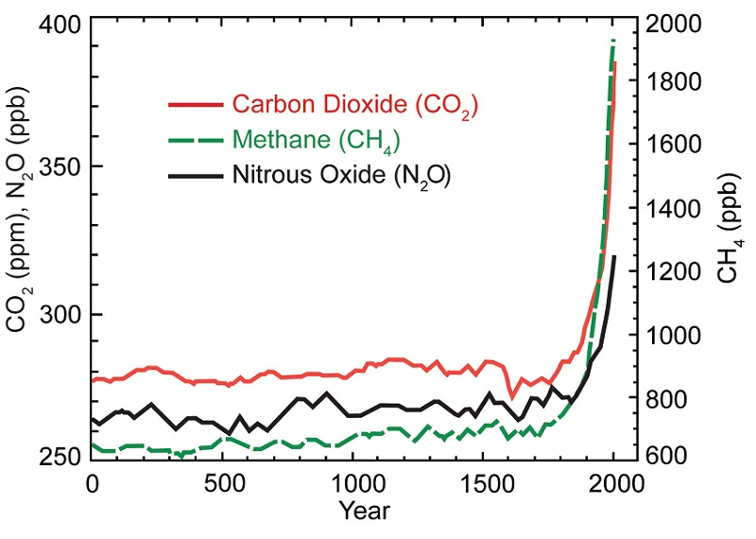
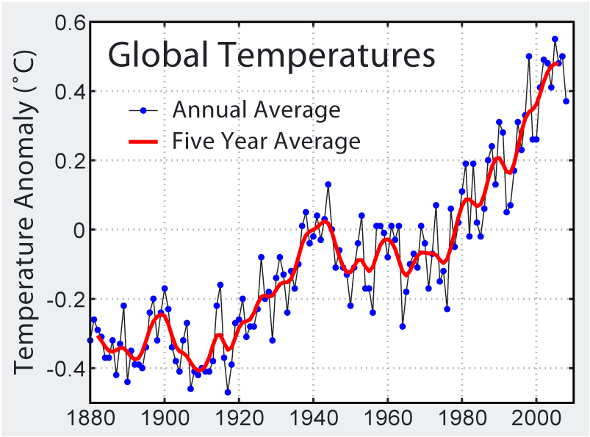
Influence of Industrial Revolution
Amounts of G.H. Gases – p. 385
industrial revolution
Average Global Temperature – p. 373

Slide 20
Extra
http://whatsyourimpact.org/

