Slide 1
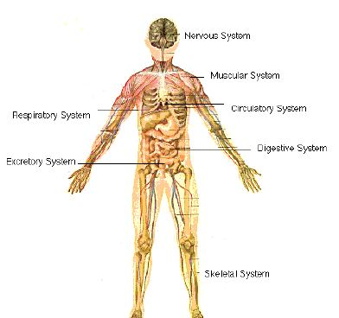
Name that system!

Slide 2
???
Supports us & allows movement

Slide 3
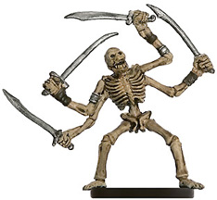
Muscularskeletal System
Supports us & allows movement

Slide 4
???
Getting rid of waste products

Slide 5
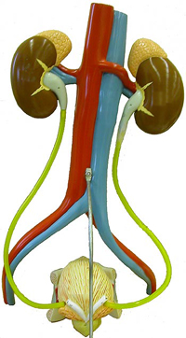
Excretory System
Getting rid of waste products

Slide 6
???
In with good stuff & out with bad. (double diffusion)

Slide 7
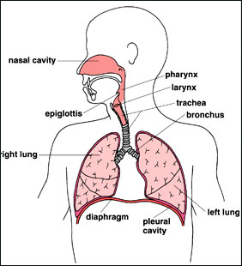
Respiratory System
In with good stuff & out with bad. (double diffusion)

Slide 8
???
Keep things flowing to & from cells

Slide 9
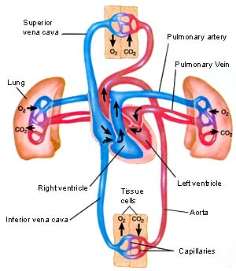
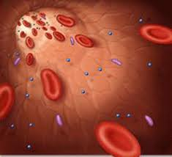
Circulatory System
Keep things flowing to & from cells

Slide 10
???
Respond to changes inside and outside
of body.

Slide 11
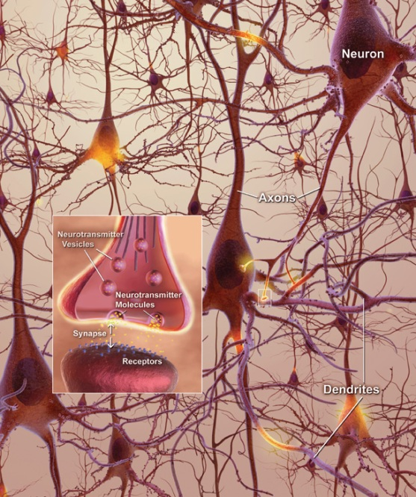
Nervous System
Respond to changes inside and outside
of body.
http://www.youtube.com/watch?v=cNaFnRKwpFk&feature=player_embedded

Slide 12
???
Breaks down big things to small.
(diffusion)

Slide 13
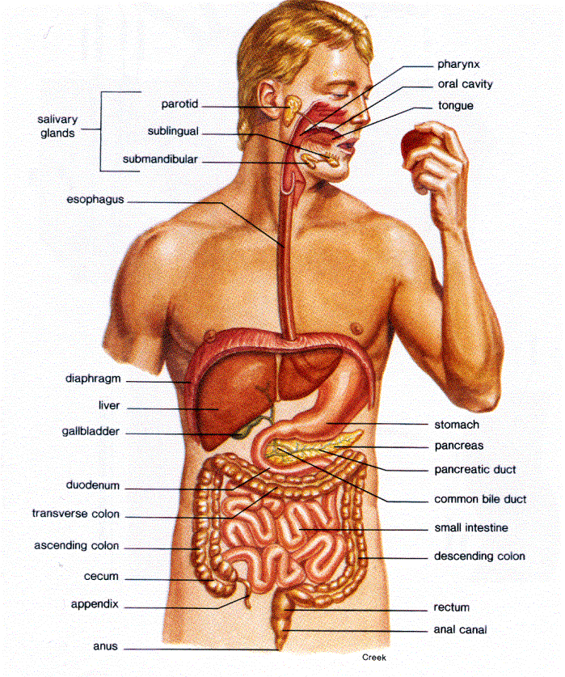
Digestive System
Breaks down big things to small.
(diffusion)

Slide 14
???
Makes another copy

Slide 15
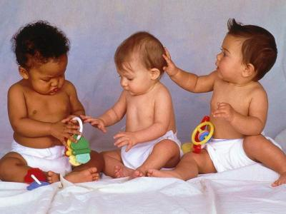
Reproductive System
Makes another copy

Slide 16
???
Protects from foreign bodies

Slide 17
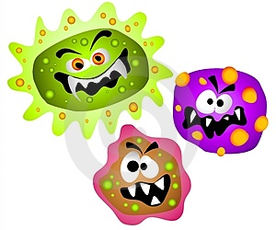
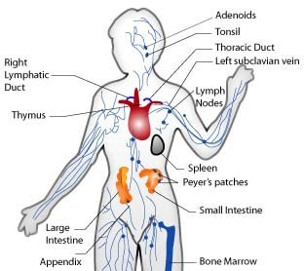
Immune system
Protects from foreign bodies

Slide 18
???
Regulates slow processes ie: metabolism, growth, reproduction

Slide 19
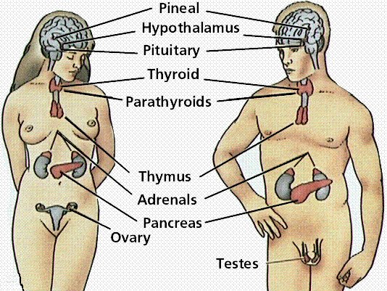
Endocrine system
Regulates slow processes ie: metabolism, growth, reproduction

Slide 20
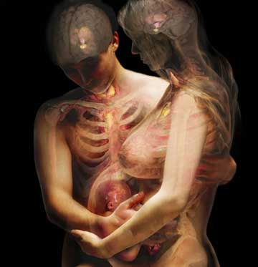
The End….

