Slide 1
Some Properties of Light

Slide 2
#1
• Light travels in a straight line
(light beam, shadows)

Slide 3
#2
• Light travels at ‘c’
or 3 x 10⁸ m/s in a vacuum (deep space)

Slide 4
#2
• Light travels at ‘c’
or 3 x 10⁸ m/s in a vacuum (deep space)
Note: Nothing goes faster than this! (says Einstein)

Slide 5
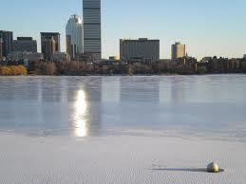
#3
• Light can reflect (off smooth, shiny surface).

Slide 6
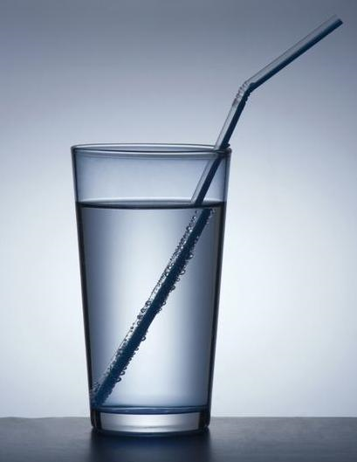
#4
• Light refracts (bends when it enters a new medium)

Slide 7
• Light refracts (bends when it enters a new medium)
Note: medium = something light travels through

Slide 8
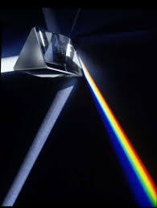
#5
• White Light is composed of 7 colours: ROYGBIV

Slide 9
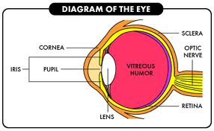
“Seeing”
You ‘see’ something when the light from that object somehow reaches the retina at the back of your eye.

Slide 10
Terminology
Can light travel through a medium?

Slide 11
Terminology
Can light travel through a medium?
• Yes? = transparent ie: glass

Slide 12
Terminology
Can light travel through a medium?
• Yes? = transparent ie: glass
This means I can see a clear image,
like looking out a window.

Slide 13
Terminology
Can light travel through a medium?
• No? = opaque ie: book

Slide 14
Terminology
Can light travel through a medium?
• No? = opaque ie: book
This means I cannot see an image at all.

Slide 15
Terminology
Can light travel through a medium?
• Somewhat? = translucent
ie: glass block, frosted glass

Slide 16
Terminology
Can light travel through a medium?
• Somewhat? = translucent
ie: glass block, frosted glass
This means light gets through but there is NOT a clear image.

Slide 17
But what IS light?
• Light is energy. (no mass, no volume)
- late 1800’s
- that model works for us!

Slide 18
But what IS light?
But…
• Light is a particle (photon) says Einstein

Slide 19
But what IS light?
So….
• Modern theory says light is both
“Wave-particle duality theory”.

Slide 20
• EMR (electromagnetic radiation spectrum) explains light as energy.
….show video…..

Slide 21
• Every different kind of light has a different wavelength and a different energy.
….sketch on board. …

Slide 22
• Laser light is different.
L = Light
A = amplification
S = stimulated
E = emission
R = radiation

Slide 23
Sources of light
• If something gives off light, it is said to be luminous.

Slide 24
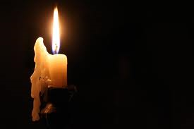
Sources of light
• If something gives off light, it is said to be luminous.
• If something does NOT give off light, it is said to be non- luminous.

Slide 25
• Not many things are luminous!

Slide 26
Seatwork
#1. Scan/read 11.2 & copy down 7 sources of light & 1 example from each.
Answer # 1, 2, 4, 5, 7, 8, 10
#2. Read 11.3: Laser Light
Answer # 1 – 4

